Slide 1
LUIS Language Understanding Intelligent Service
Notes:
We will go quickly through these slides, as it should be mostly a review of yesterday

Slide 2
Why NLU?
Any user interface could benefit from Natural Language Understanding
Rise of conversation-based applications
Need to extract meaning from context
We are not all data scientists, but we all need to be able to integrate NLU into our applications
Notes:
Understanding NLU Stanford presentation: https://nlp.stanford.edu/~wcmac/papers/20140716-UNLU.pdf
Wikipedia: https://en.wikipedia.org/wiki/Natural_language_understanding
Why chatbots won’t survive without NLU: https://chatbotsmagazine.com/why-chatbots-wont-survive-without-nlu-df3670e911c5

Slide 3
Microsoft’s LUIS
A machine learning-based service to build natural language understanding into apps, bots, and IoT devices
Quickly create enterprise-ready, custom models that continuously improve
Exportable to containers
Web and programmatic interfaces
Notes:
LUIS whitepaper: https://www.microsoft.com/en-us/research/wp-content/uploads/2016/02/sigdial2015demo.pdf
https://www.luis.ai/

Slide 4
Luis Development Process
Intents
Utterances
Entities
Training and testing
Publishing
Features/Patterns
Active learning

Slide 5
Key LUIS concepts
Intents
Actions the user wants to perform
Utterances
Text input from a user your app needs to understand
Entities
Detailed information (parameters) relevant to the Intent / utterance
Intent | Sample user utterance | Entities
BookFlight | “Book a flight to Seattle?” | Seattle
StoreHoursAndLocation | “When does your store open?” | open
ScheduleMeeting | “Schedule a meeting at 1PM with Bob in Distribution” | 1PM, Bob
Notes:
1. https://docs.microsoft.com/en-us/azure/cognitive-services/luis/home

Slide 6
Key Initial Good Practices
Begin with 10-15 utterances per intent
Collect phrases that you think users will say
Use the representative language of the user
Include utterances that mean the same but are constructed differently.
Be mindful that utterances aren't always well formed
Choose varied terminology as well as phrasing
None intent should have between 10-20 % of the total utterances.
Notes:
1. https://docs.microsoft.com/en-us/azure/cognitive-services/luis/home

Slide 7
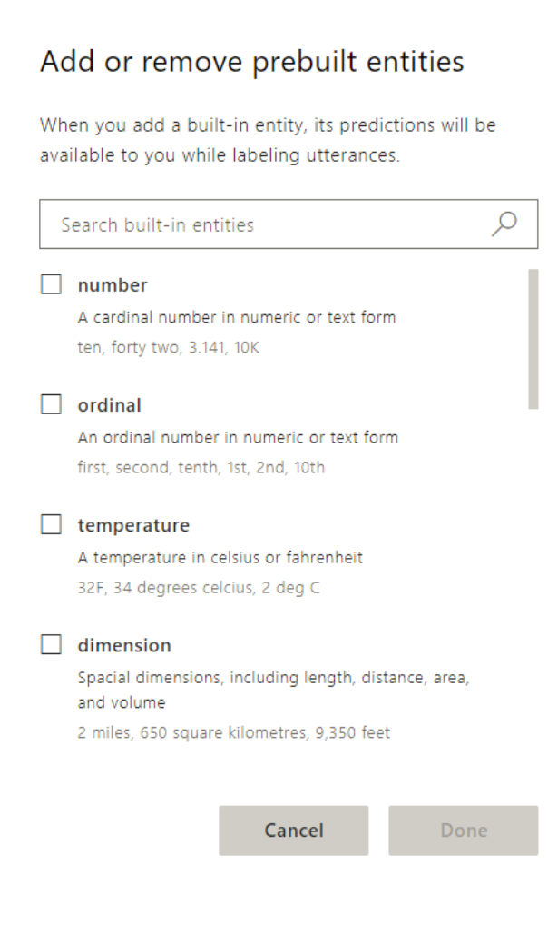
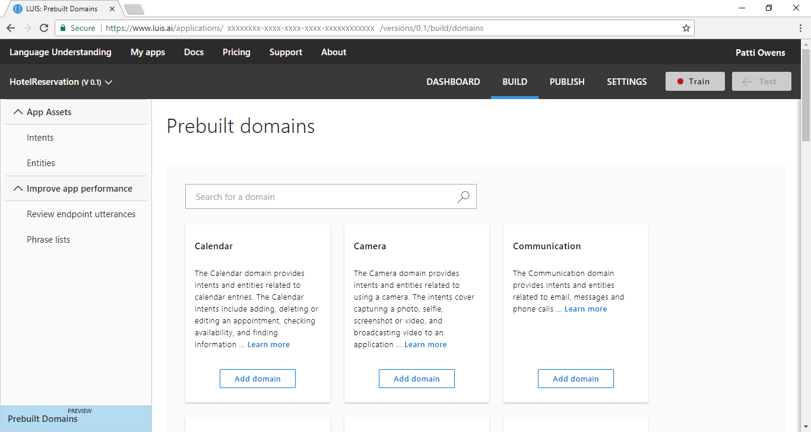
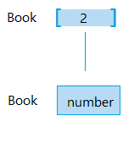
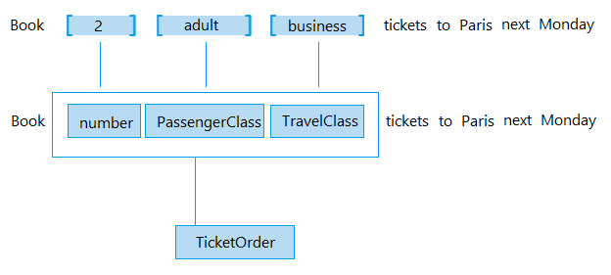
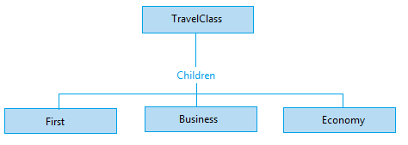
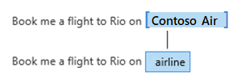
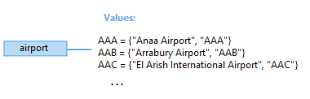
Key LUIS concepts
Simple entities
Hierarchical entities
Composite entities
Built-in entities
Prebuild Domains
List entities
Notes:
Plan your app: https://docs.microsoft.com/en-us/azure/cognitive-services/luis/plan-your-app
Prebuilt entity: https://docs.microsoft.com/en-us/azure/cognitive-services/luis/pre-builtentities
Prebuilt domains: https://docs.microsoft.com/en-us/azure/cognitive-services/luis/luis-how-to-use-prebuilt-domains
Best practices: https://docs.microsoft.com/en-us/azure/cognitive-services/luis/luis-concept-best-practices#entities
Recognizer-Texts, code behind prebuilt entities: https://blog.botframework.com/2018/01/24/contributing-luis-microsoft-recognizers-text-part-1/

Slide 8
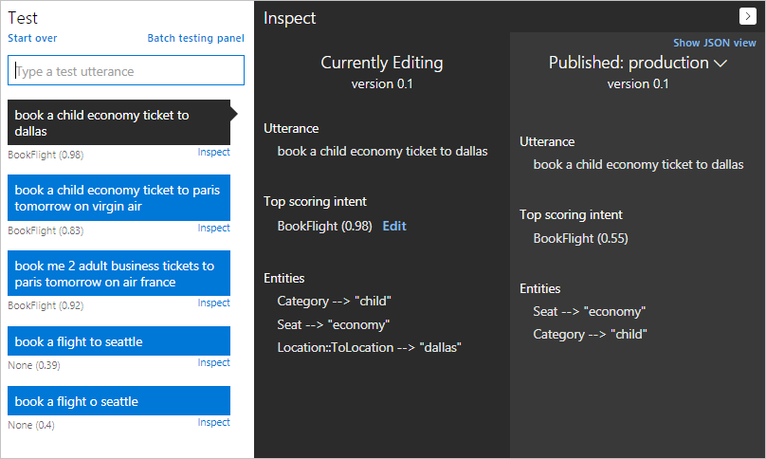
Testing your model
Notes:
Train your model: https://docs.microsoft.com/en-us/azure/cognitive-services/luis/luis-how-to-train
Interactive testing: https://docs.microsoft.com/en-us/azure/cognitive-services/luis/train-test
Batch testing: https://docs.microsoft.com/en-us/azure/cognitive-services/luis/luis-how-to-batch-test

Slide 9
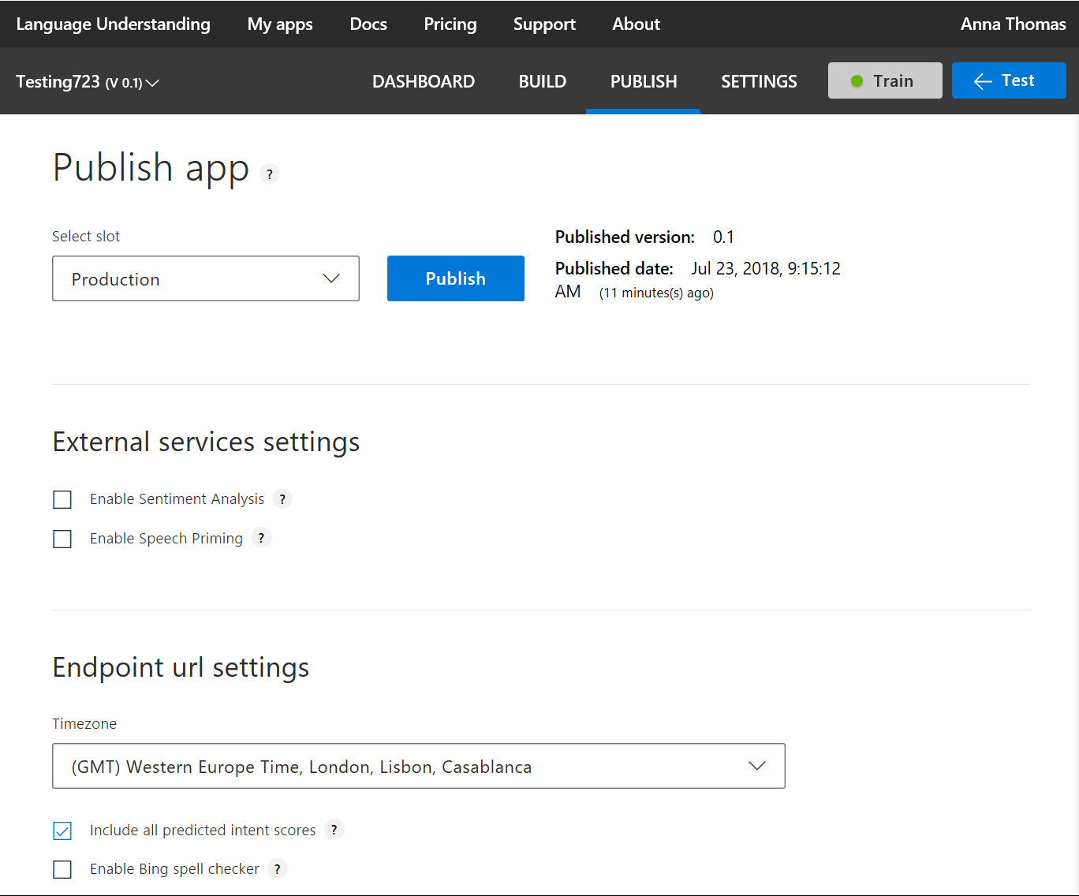
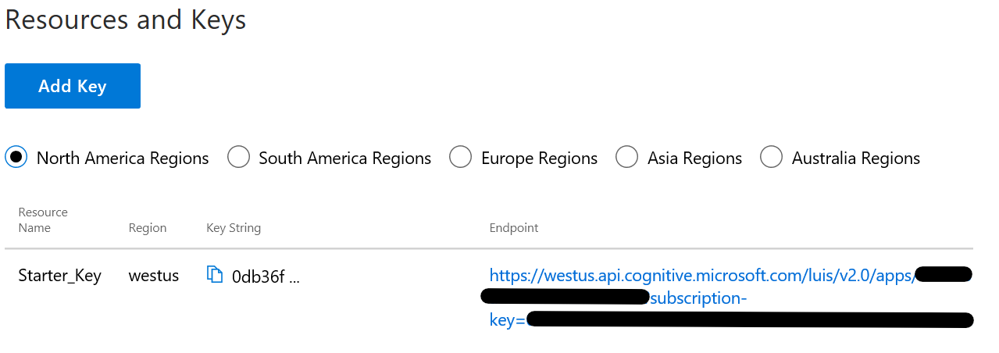
Publishing your model
Notes:
1. Publish your model: https://docs.microsoft.com/en-us/azure/cognitive-services/luis/publishapp

Slide 10
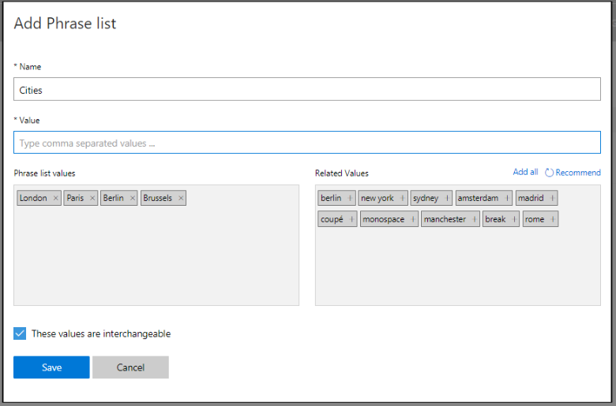
Adding features to improve performance
Features help LUIS by providing hints that certain words and phrases are part of a category
Notes:
Add features: https://docs.microsoft.com/en-us/azure/cognitive-services/luis/add-features
10 phrase list must-haves blog: https://blogs.msdn.microsoft.com/benjaminperkins/2016/12/07/top-10-must-have-phrase-list-features-for-your-chatbot-or-any-bot-luis/

Slide 11
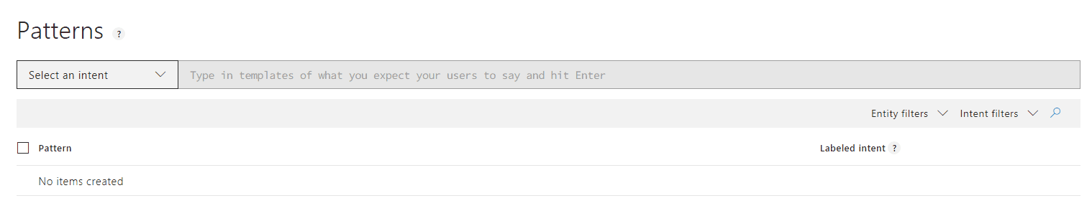
Adding patterns to improve performance
Patterns are template utterances with placeholders for entities used to further improve your model
Notes:
Authoring cycle: https://docs.microsoft.com/en-us/azure/cognitive-services/luis/luis-concept-app-iteration
Label endpoint utterances: https://docs.microsoft.com/en-us/azure/cognitive-services/luis/label-suggested-utterances

Slide 12
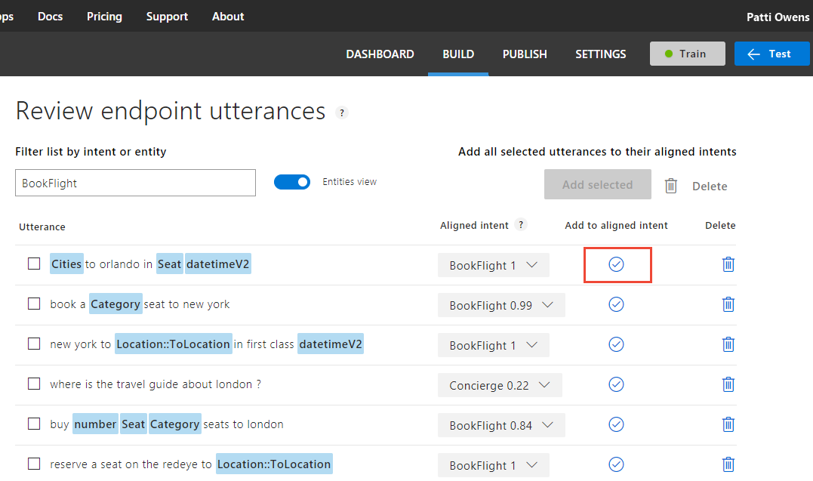
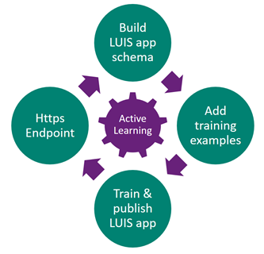
Using active learning
Notes:
Authoring cycle: https://docs.microsoft.com/en-us/azure/cognitive-services/luis/luis-concept-app-iteration
Label endpoint utterances: https://docs.microsoft.com/en-us/azure/cognitive-services/luis/label-suggested-utterances

Slide 13
DOs
DON’Ts
Define discriminative intents
Find a sweet spot between too generic & too specific
Build your app iteratively
Add phrase lists & patterns in later iterations
Add examples to NONE (proportional to other intents)
Leverage the suggest feature
Monitor the performance of your app
Add plenty of labels
Use LUIS as a training platform
Add many examples of the same format ignoring other formats
Mix the definition of intents & entities
Create phrase lists with all the possible values
Add so many patterns
Train & publish with every single example
Notes:
Do’s
Book a flight + book an hotel OR Just “Book” + 2 entities (flight and Hotel)
Test set x real traffic on the endpoint. Adjust the test set
1 none example for every 10 utterances
Don’ts
Few examples of a good model is better than too much labels

Slide 14
DOs
DON’Ts
Examples
Book a flight Intent + book an hotel Intent OR Just “Book” + 2 entities (Flight and Hotel)
Define intents when they map to actions the bot will take, but with the condition that their semantics don’t overlap
Leverage the real traffic data on the endpoint
1 none example for every 10 utterances
Examples
Lots of labeled data upfront before starting with LUIS. Don’t upload all the data and use LUIS as a training platform on the cloud.
LUIS is an interactive machine learning platform where developers can build cost effective models. Fewer and effective examples is a more effective approach
Notes:
- Add plenty of labels: on that front, some customers would have a lot of labeled data upfront before starting with LUIS. In this case you don’t need to upload all the data and use LUIS as a training platform on the cloud. LUIS is an interactive machine learning platform where developers can build cost effective models. By that I mean the fewest labels to retain the same accuracy compared to traditional machine learning approaches
- Mix the definition of intents and entities: on that front, there are cases where you don’t know how to design your schema and there is no right or wrong but there is good and worse design. For example, if you are designing a reservation bot for hotels and travel, you might decide to have two intents (one for booking a flight and another booking a hotel). The other design option is to create one booking intent and two types of entities (hotel and flight). I would say a good design practice is to define intents when they map to actions the bot will take but with the condition that their semantics don’t overlap so that we don’t’ confuse the system with highly overlapping training examples to the two intents. If you find yourself in this situation, you need to revisit your design. To a large extent, this is controlled by the nature of the data of your application and how people tend to express their intentions in a given domain

Slide 15
More Good Practices and Limits
Batch Upload of Intents, Entities and Utterances
Leverage Dispatch Tool – routing up to 500 endpoints
Leverage Q&A Maker, reducing the number of intents
Limits per Luis APP
500 Intents
50 Lists
50 parent Entities, 20K child
500 patterns
No limit for prebuilt entities
Notes:
https://docs.microsoft.com/en-us/azure/bot-service/bot-builder-tutorial-dispatch?view=azure-bot-service-4.0&tabs=csharp
https://docs.microsoft.com/en-in/azure/cognitive-services/luis/luis-boundaries

Slide 16
LearnAI - Designing and Architecting Intelligent Agents http://aka.ms/LearnAI-daaia
To learn more…

Slide 17
https://github.com/Azure/LearnAI-Airlift
Next Lab: LUIS

